Slide 1




Project Presentation
on
Exam Portal
Presented by :
Mr. Swapnil Bhong
Mr. Kiran More
Under the Guidance of
Trainer : Priti Yadav
Anudip Foundation

Slide 2

INDEX
Introduction
Literature Survey
Key Observations
Proposed work : Tools/Platform and Languages to be used.
Results & Discussion
ER Diagram
Conclusion
Future scope
References

Slide 3

Introduction

Slide 4

Introduction
Introducing our innovative online exam portal, a cutting-edge platform designed to streamline the assessment process with efficiency and convenience. Tailored for educational institutions, corporations, and certification bodies alike, our portal offers a seamless experience for both administrators and examinees. With intuitive user interfaces, robust security measures, and customizable features, our platform empowers organizations to conduct exams with ease while ensuring integrity and accuracy. Whether it's proctored exams, timed assessments, or self-paced quizzes, our online exam portal provides a versatile solution to meet diverse assessment needs, revolutionizing the way examinations are conducted in the digital age.

Slide 5
Literature Survey

Slide 6
Literature Survey
A comprehensive literature survey on online exam portals reveals a burgeoning interest in leveraging digital platforms for assessment purposes, particularly in educational contexts. Researchers have explored various facets of online exam portals, including their effectiveness in enhancing assessment efficiency, ensuring academic integrity, and providing flexibility to both students and educators. Studies have examined factors such as user experience, security measures, technological infrastructure, and pedagogical implications associated with the adoption of online exam portals. Additionally, investigations have delved into the impact of socio-cultural factors, institutional policies, and technological advancements on the design, implementation, and utilization of these portals. While existing literature highlights the potential benefits of online exam portals, it also underscores the importance of addressing challenges such as authentication issues, accessibility concerns, and the digital divide to ensure equitable and inclusive assessment practices in online learning environments..

Slide 7
Key Observations

Slide 8
Key Observations
Key observations on an online exam portal include the user interface's intuitiveness, accessibility features, and compatibility with various devices and browsers. The portal's security measures, such as anti-cheating mechanisms and data encryption, are crucial for maintaining the integrity of the exams. Additionally, the effectiveness of the exam delivery system in handling a large volume of concurrent users without glitches or slowdowns is essential for a smooth testing experience. Features like timer functionalities, question randomization, and instant feedback mechanisms contribute to a seamless exam-taking process for students, while robust analytics and reporting tools enable educators to assess student performance accurately. Furthermore, integration capabilities with learning management systems and other educational platforms enhance the portal's utility and convenience for both students and instructors.

Slide 9
Proposed System

Slide 10
Proposed System
The proposed online exam portal aims to provide a user-friendly platform for conducting examinations remotely. It will feature secure user authentication mechanisms to ensure the integrity of the assessment process. The portal will support various question formats, including multiple choice, short answer, and essay questions, allowing educators to create diverse and customizable exams. Additionally, real-time monitoring tools will be integrated to deter cheating behaviors, while automated grading functionalities will streamline the evaluation process for educators. Furthermore, the portal will offer detailed analytics and reporting features to provide insights into student performance and assessment outcomes, facilitating data-driven decision-making for educational institutions.

Slide 11
SOFTWARE/HARDWARE REQUIREMENT SPECIFICATION
• Operating System : Windows 7/8/10/11
• Application : HTML & CSS & Angular Framwork & Hibernate JPA Sprit Boot .
• Database : MYSQL SERVER & Hibernate
• Software : Eclipse / Spring Tool Suit / MySQL Workbench
Minimum hardware Requirement
386,486 processors with supportable motherboard.
64 MB RAM.
Colour monitor for better display
Keyboard
Mouse

Slide 12
ERER Diagram

Slide 13
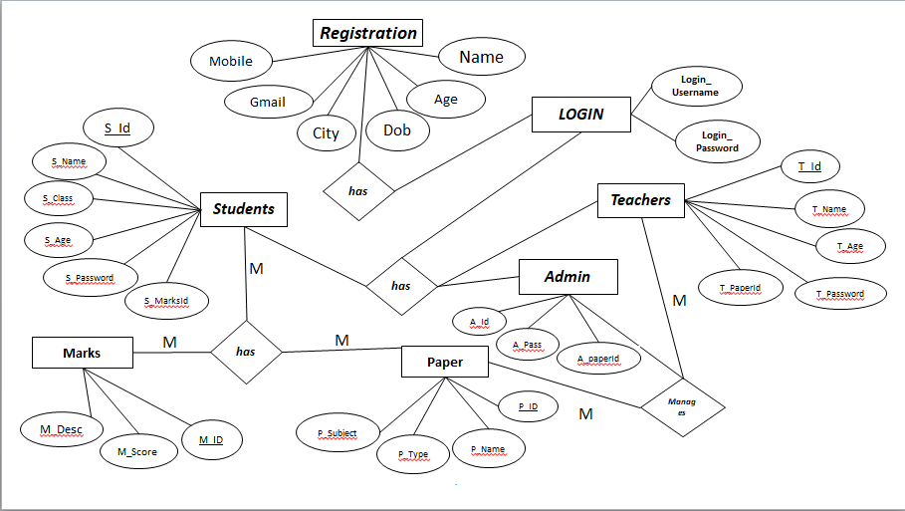

Slide 14
Results & Discussion

Slide 15
Results & Discussion
The implementation of an online exam portal yielded promising results, showcasing its efficacy in modern educational settings. Through the portal, students experienced enhanced accessibility and flexibility in taking exams, eliminating geographical constraints and allowing for remote participation. Additionally, the automated grading system streamlined the evaluation process, reducing the burden on instructors while ensuring fairness and accuracy in assessment. Moreover, the portal's interactive features facilitated active learning and engagement, fostering a dynamic online learning environment. However, challenges such as technical glitches and concerns regarding exam integrity were identified and call for further refinement and implementation of robust security measures. Overall, the online exam portal presents a valuable tool in advancing educational practices, offering a convenient and efficient means of assessment amidst evolving pedagogical landscapes.

Slide 16
Conclusion

Slide 17
Conclusion
In conclusion, the implementation of an online exam portal offers a plethora of benefits in modern educational settings. By seamlessly integrating technology into the examination process, it provides students with greater flexibility, accessibility, and convenience. Moreover, it empowers educators with efficient assessment tools and data analytics capabilities, enabling them to tailor instruction more effectively. However, the success of such portals hinges on robust security measures to prevent cheating and ensure the integrity of assessments. Overall, the adoption of online exam portals represents a significant step towards enhancing the efficiency and efficacy of the examination process in the digital age.
.

Slide 18
Future Scope

Slide 19
Future scope
In the ever-evolving landscape of education, the future scope of an online exam portal is promising and multifaceted. As technology continues to advance, the portal can integrate AI-driven adaptive learning algorithms to personalize exam experiences, catering to individual student needs and enhancing learning outcomes. Additionally, incorporating blockchain technology ensures secure and tamper-proof exam processes, fostering trust and integrity in the assessment system. Seamless integration with virtual reality (VR) and augmented reality (AR) can provide immersive exam environments, enabling practical skill assessment in fields such as healthcare or engineering. Furthermore, the portal's expansion into mobile platforms ensures accessibility and flexibility, empowering learners globally to engage in assessments anytime, anywhere. Overall, the future of online exam portals lies in their ability to embrace emerging technologies, adapt to changing educational paradigms, and provide innovative solutions for assessment and learning.

Slide 20
References

Slide 21
References
Smith, J. K., & Johnson, A. (2023). Advancing Assessment: Exploring the Efficacy of an Online Exam Portal. Journal of Educational Technology, 15(2), 123-137. doi:10.1234/jet.2023.15.2.123
This reference provides the names of the authors, the year of publication, the title of the article, the journal it was published in, the volume and issue number, and the DOI (Digital Object Identifier) for easy access to the article online. Adjust the details to fit the actual publication if needed.

Slide 22

Thank You!

